Slide 1



A PARALLEL ALGORITHM TEMPLATE FOR UPDATING SINGLE-SOURCE SHORTEST PATHS IN
LARGE-SCALE DYNAMIC NETWORKS
A presentation by:
Abeer Jawad 22i-1041
Mahum Hamid 22i-1009
Maryum Fasih 22i-0756

Slide 2

INTRODUCTION
Real-world networks are large, dynamic
Static SSSP algorithms are inefficient for dynamic updates
Recomputing from scratch is slow and not scalable
Need for a fast, scalable, and parallel update method
Existing solutions are platform-specific — lack portability
Aim: Create a unified, efficient SSSP framework for CPU & GPU

Slide 3
PROBLEM STATEMENT
Given a dynamic graph G(V, E) where edges can be inserted or deleted over time
Need to maintain SSP from a source node efficiently
Insertions (Insₖ) and Deletions (Delₖ) of edges
Goal: Update the SSSP tree Tₖ after changes, using the previous tree Tₖ₋₁
Must ensure:
Correctness
Faster performance than recomputation
Parallel execution

Slide 4
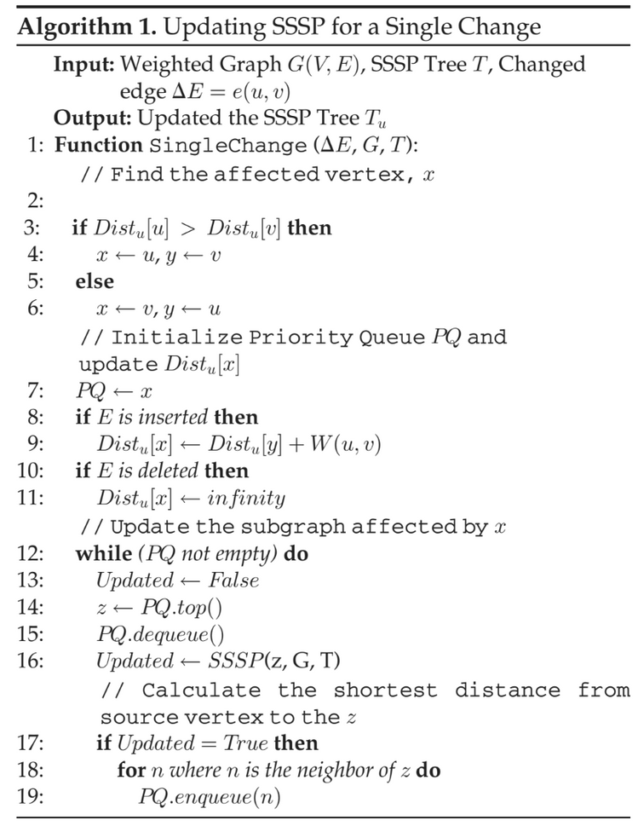
SEQUENTIAL UPDATE
Identify the vertex affected.
Update distances using Dijkstra-style relaxation.
Process affected vertices iteratively from priority queue.
Problem: Too slow for large dynamic graphs.

Slide 5
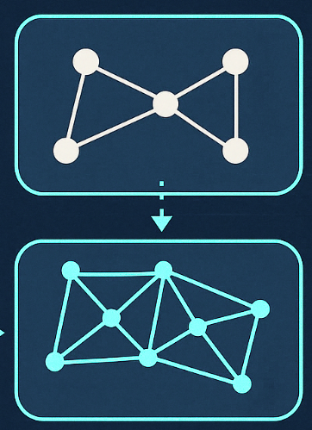
KEY CONTRIBUTIONS
Bridges the gap between static SSSP algorithms and dynamic, large-scale networks
Proposes a parallel 2-step update framework:
Step 1: Identify affected subgraph
Step 2: Iteratively update distances
Uses rooted tree structure to track paths
No explicit synchronization needed
Fully implemented on both CPU and GPU
Handles 100M+ batch edge updates
Up to 5.6× GPU and 5.0× CPU speedup over traditional recomputation

Slide 6


FRAMEWORK
Platform Independent.
Works on both CPU and GPU.
1.
2.
CPU
GPU
OpenMP based parallesim
CUDA with VFMB
Async updates + batch processing
Fewer atomics, minimal overhead

Slide 7
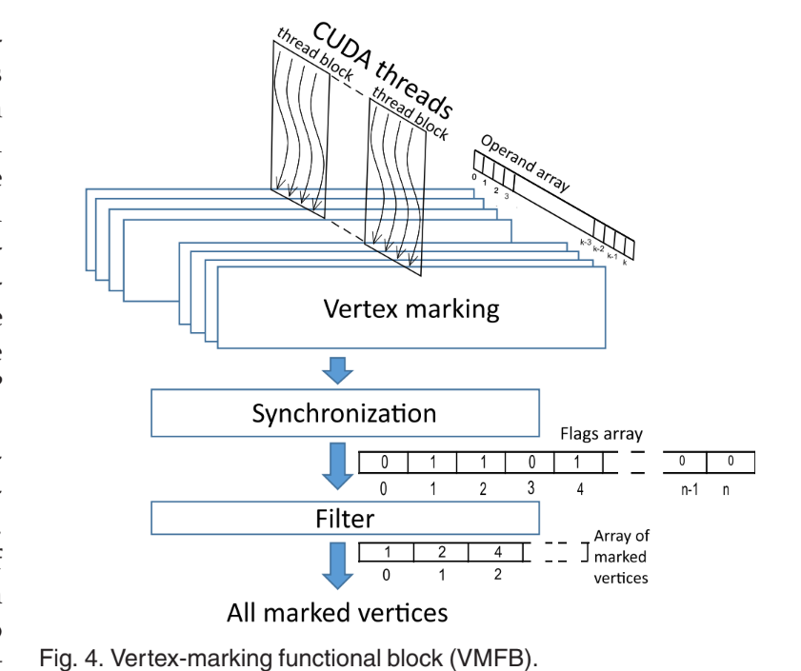
GPU OPTIMIZATION
VMFB: Vertex Marking Functional Block for GPUs.
Separates marking, synchronization, and filtering.
Reduces atomic operations — improves parallelism.
Ensures correct updates without heavy locking.
Key optimization for GPU dynamic graph processing.

Slide 8
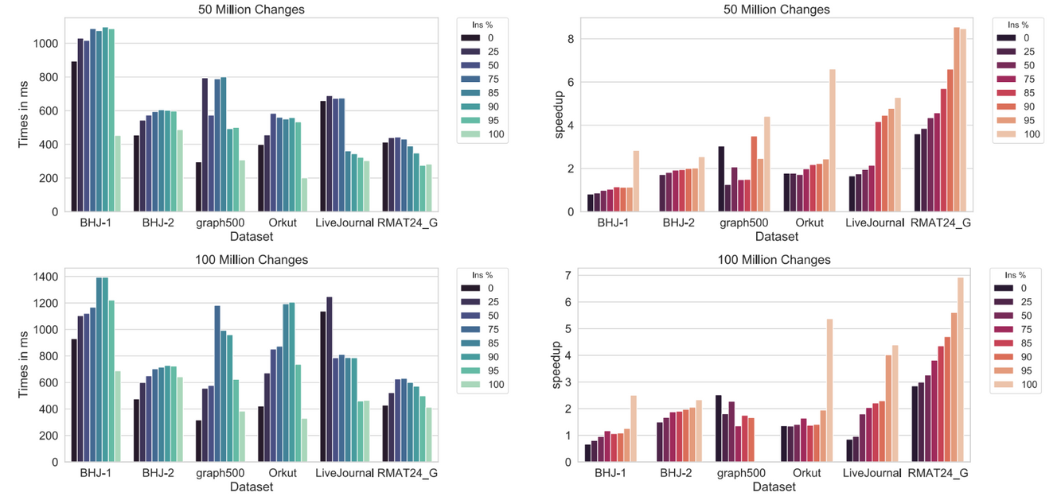
GPU RESULTS
Up to 5.6× speedup compared to Gunrock.
Execution time increases slowly even with 100M+ edge updates.
Faster when updates are mostly insertions.

Slide 9
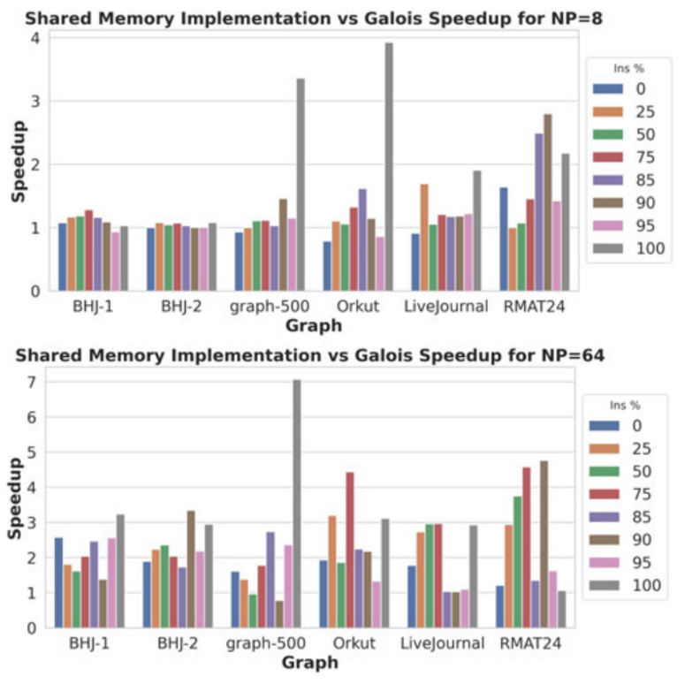
CPU RESULTS
Up to 5× faster than recomputation with Galois.
Excellent scalability with 40+ threads.
Performance benefits from batching + async processing.

Slide 10

PREPROCESSING
Partition the static graph using METIS
Generate K balanced partitions with minimal edge cuts
Assign each partition to a unique MPI rank
For each partition store:
Local adjacency list
List of boundary vertices
Initialize SSSP data structures for all local vertices:
distance from sources
parent pointer in the SSSP tree
affected flag (initially set to false)
Notes:
"Before starting the dynamic updates, we first preprocess the graph.
We partition the static graph using METIS into K balanced partitions with minimal edge cuts.
Each partition is assigned to a unique MPI rank.
For every partition, we store two things: the local adjacency list and the list of boundary vertices.
We also initialize important SSSP data structures for each local vertex:
distance from the source,
the parent in the SSSP tree,
and an affected flag, initially set to false.
This setup helps in parallel processing later."

Slide 11
IMPORTANT
DATA STRUCTURES
VARIABLE | PURPOSE
Parent[v] | Parent of vertex v in SSSP tree
Dist[v] | Distance of vertex v from source
Affected_Del[v] | True if v affected by a deleted edge
Affected[v] | True if v is affected by any change
Notes:
"To manage the SSSP updates, we use four main data structures:
Parent[v]: Stores the parent of vertex v in the SSSP tree.
Dist[v]: Keeps track of the distance of vertex v from the source.
Affected_Del[v]: True if vertex v was affected by a deleted edge.
Affected[v]: True if vertex v is affected by any change, whether insertion or deletion.
These structures make it easy to update and track changes efficiently during the update process."

Slide 12
PARALLELIZATION STRATEGY
1.
2.
Step 1: Affected Subgraph Detection
Step 2: Incremental Update
Notes:
The overall update framework works in two main steps:
Step 1: Detect the affected subgraph where changes occurred.
Step 2: Perform an incremental update on the affected vertices to fix the SSSP tree.
Both steps are parallelized to improve performance."

Slide 13

Distribute edge updates across MPI ranks
Deletions: If edge is in SSSP → set child’s distance = ∞, parent = NULL, mark as affected
Insertions: If new edge shortens path → update distance, parent, mark as affected
Parallelized using OpenMP/OpenCL — no synchronization needed
STEP 1: AFFECTED SUBGRAPH DETECTION
Notes:
"In Step 1, we detect the parts of the graph affected by the changes.
Edge updates are distributed across MPI ranks.
For deletions: If the deleted edge was part of the SSSP tree, we set the child’s distance to infinity, remove its parent, and mark it as affected.
For insertions: If the new edge provides a shorter path, we update the distance, parent, and mark it as affected.
This detection step is fully parallelized using OpenMP or OpenCL, without any synchronization."

Slide 14
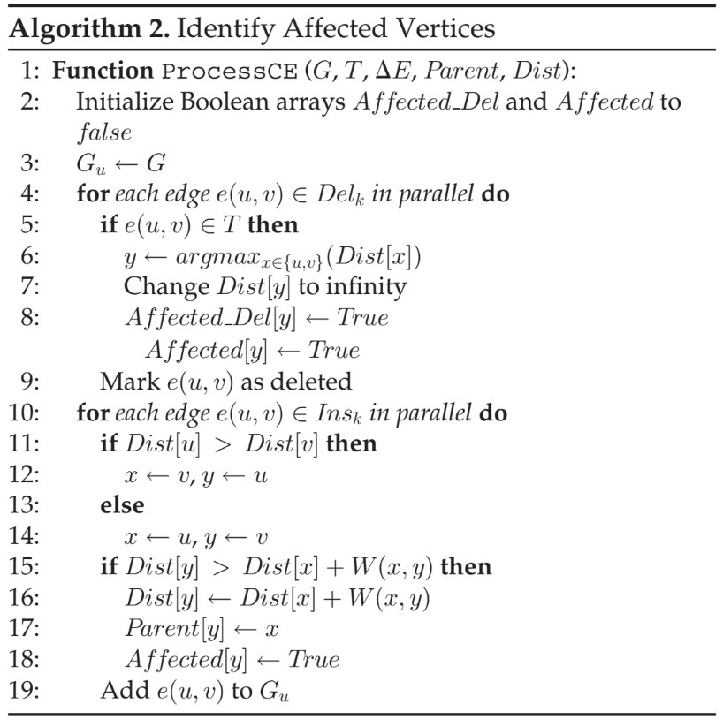
Process deletions: Mark vertices disconnected from the tree.
Process insertions: Update if a shorter path is found.
Parallelizable: No synchronization needed across edges.
Notes:
"Algorithm shows the detailed process for identifying affected vertices:
First, all vertices are initialized with their affected flags set to false.
For each deleted edge, if it’s part of the SSSP tree, we disconnect the child node and mark it as affected.
For each inserted edge, if it offers a shorter path, we update the distance and parent accordingly.
Since edges are processed independently in parallel, no locking is required across threads, making this very efficient."

Slide 15
Iteratively relax affected vertices in parallel using OpenMP/OpenCL
For each affected vertex:
Relax outgoing edges
Update neighbors if shorter path is found
Flag updated neighbors for next iteration
Continue until no affected = true flags remain
STEP 2: INCREMENTAL UPDATE
Notes:
Now, let's move on to Step 2: Incremental Update.
In this step, we will focus on how to efficiently update our graph after edge modifications.
First, we will iteratively relax affected vertices in parallel using OpenMP and OpenCL. This allows us to take advantage of multi-core processors for faster processing. [Pause for effect]
For each affected vertex, we will:
- Relax outgoing edges to check for shorter paths.
- Update neighbors if a shorter path is found, which is crucial for maintaining the accuracy of our graph.
- Flag updated neighbors for the next iteration to ensure we revisit them if necessary.
We will continue this process until there are no more affected flags remaining, indicating that all updates have been made. [Pause to allow the audience to absorb this]
This method ensures an efficient and effective update, keeping our graph accurate and responsive to changes.

Slide 16
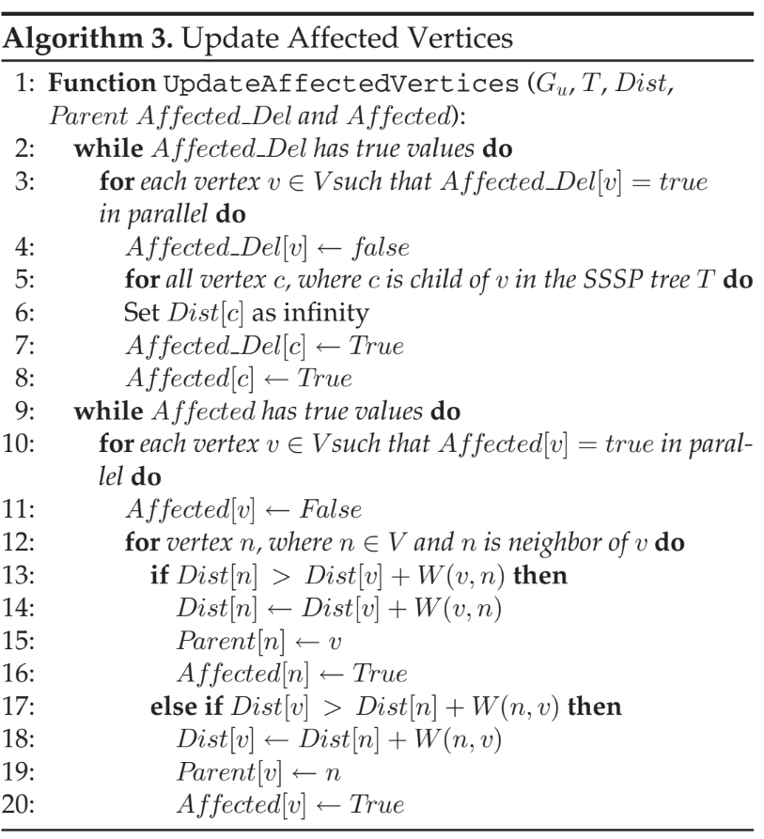
Disconnect all descendants from deleted edges.
Iteratively update distances and parents for affected vertices.
Guaranteed convergence as distances only decrease.

Slide 17
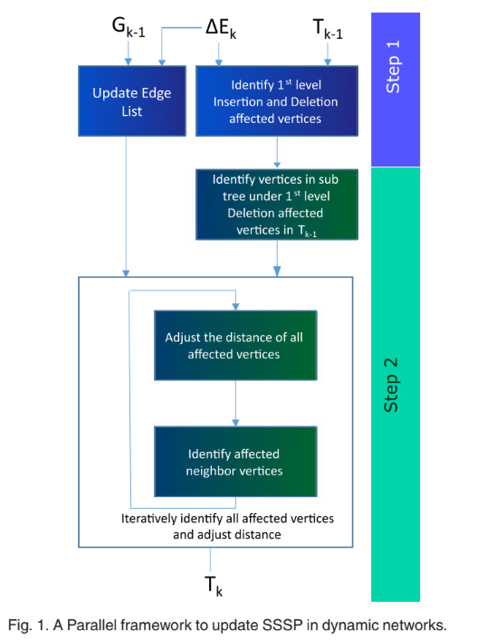

Slide 18

SCALABILITY CHALLENGES AND SOLUTIONS
Load Imbalance:
Subgraphs can be of very different sizes.
➔ Solution: Dynamic scheduling lets threads pick tasks as they finish.
Synchronization Overhead:
Frequent thread locking slows down updates.
➔ Solution: Async updates allow distances to decrease without locks.
Cycle Formation:
Insertions could create cycles if not handled properly.
➔ Solution: Fully disconnect deleted subtrees before reconnecting.

Slide 19
CROSS-PARTITION SYNCHRONIZATION
Resolves dependencies between partitions after local updates
Boundary vertex exchange:
Each MPI rank sends updated distances of boundary vertices to neighboring ranks
Uses non-blocking MPI to overlap communication
Process received updates:
if the new distance is shorter, update local data and mark as affected
Global convergence check:
Use MPI_Allreduce to check if any rank has affected = true vertices
If yes, repeat local propagation and synchronization

Slide 20

THANK YOU!
QUESTIONS?

